Slide 1
Hydrographic Services
Review Panel
Waikiki Marriott
May 6th 2011
Adam Stein
Executive Director
www.primohui.org

Slide 2
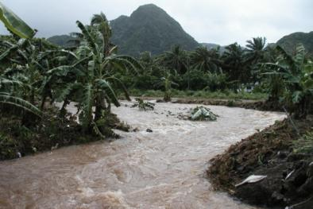
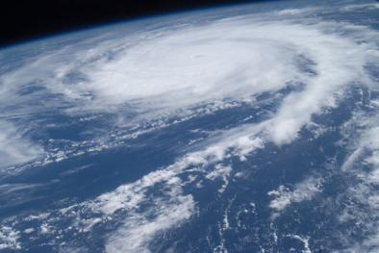
Background
Roundtable of Federal Hazard Mitigation Partners in the Pacific Islands (FHMPPI) (2002 – 2003)
  Pacific Risk Management `Ohana (PRiMO) (2004 – present)
    A consortium of local, national, and regional agencies, institutions, and organizations committed to enhancing the resilience of Pacific communities to coastal hazards and climate impacts.

Slide 3
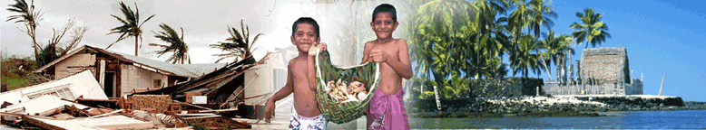
Mission
Increase collaboration to improve the development, delivery, and application of risk management products and services for Pacific communities.

Slide 4







Navigators Council
Federal Emergency Management Agency (FEMA)
Region IX Mitigation Division
National Oceanic and Atmospheric Administration (NOAA)
Coastal Services Center
Pacific Services Center
Integrated Data and Environmental Applications Center
National Weather Service Pacific Region
Pacific Marine Environmental Laboratory
Office of Oceanic and Atmospheric Research
U.S. Army Corps of Engineers
Honolulu District
Coastal and Hydraulics Lab
Environmental Protection Agency
Region IX Pacific Islands Office
U.S. Geological Survey (USGS)
Pacific Southwest Region
East-West Center
Pacific Regional Integrated Science and Assessment Program
Pacific Disaster Center
University of Hawai’i
Social Science Research Institute
Notes:
Representatives of key partner agencies that influence the use of resources and provide leadership, coordination, and policy guidance to PRiMO.

Slide 5
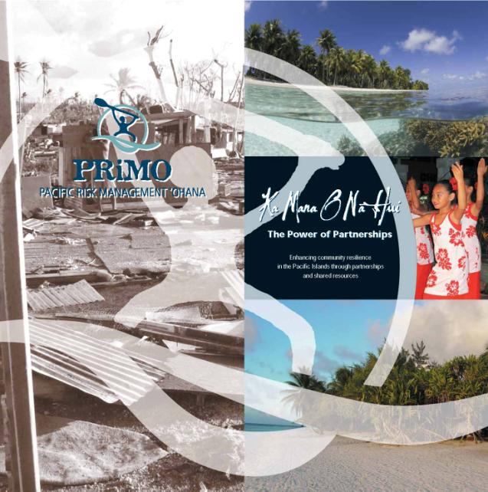
Huis
Data Analysis and Decision Support Tools
Data Management and Observations
Training
Disaster Communications
Risk Reduction and Post Disaster Evaluation
Traditional Knowledge and Practices
Education and Outreach
Notes:
Hui members are experts in their field and together bridge the information gaps between science and service providers, decision makers, and other stakeholders. Hui provide coordination and collaboration to more effectively leverage resources and positively impact activity outcomes.

Slide 6
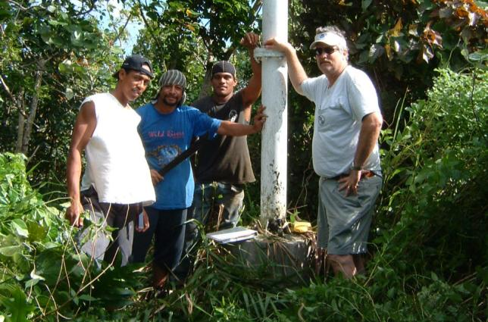
Value of Collaboration
Saves money and reduces costs
Integrates service delivery
Strengthens regional capacity
Builds relationships
Broadens perspectives and reach

Slide 7
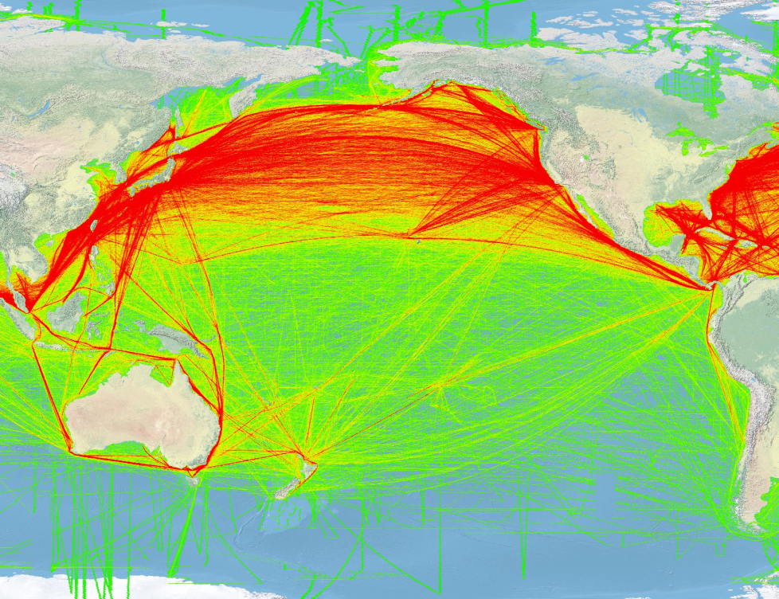
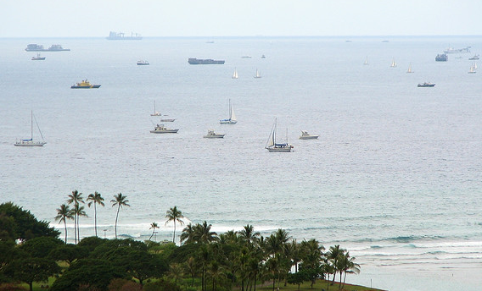
Tsunami Preparedness and Response Planning
Port Authorities
Small Boat Harbors
Recreational Boaters

Slide 8
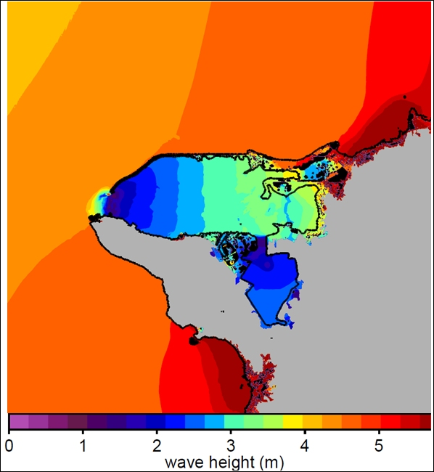
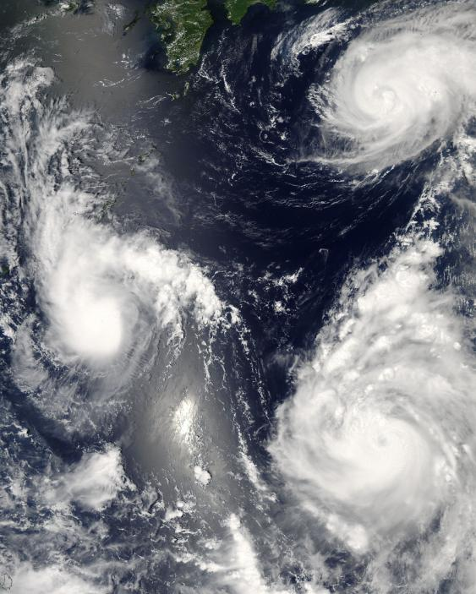
Inundation Modeling Support
High Resolution Bathymetric Data
  American Samoa
  Northwest Hawaiian Islands
Vertical Control
Water Level Observations

Slide 9
Stakeholder Engagement and
Partnership Development
Pacific Integrated Ocean Observing System (PacIOOS)
Hawaii Ocean Safety Team
Coastal Resilience Networks Program
National Tsunami Hazard Mitigation Program
PRiMO

